Slide 1
Demand and Supply Analysis
2105024 - Ayush Mohapatra
2105025 - Barenya Mohanty
2105029 - Divya Swaroop Dash
2105078 - Tejaswi Dalal
21050135 - Priyanshu Gupta

Slide 2
What is Demand and Supply Analysis?
What is Demand?
Demand refers to consumers’ need, willingness, and ability to purchase a specific product or service.
What is Supply?
Supply represents the production capacity of manufacturers and distributors. It reflects how much of a product or service can be provided to the market.
Demand and Supply Analysis is a cornerstone of economics, investigating how buyers (demand) and sellers (supply) interact to establish market equilibrium, the point where the quantity demanded by consumers equals the quantity supplied by producers, determining the market price for a good or service.
Applications
Price Determination : Demand and supply analysis helps determine fair prices for goods and services.
Agriculture : For instance, the fair price of farm yield is influenced by demand and supply dynamics.
Government Intervention : In perfectly competitive markets, governments may set minimum prices to protect farmers.

Slide 3
What we did and the Results we obtained
Data Preprocessing: We began by selecting a relevant dataset and performing the necessary preprocessing steps.
Exploratory Data Analysis (EDA): After preprocessing, we conducted an Exploratory Data Analysis (EDA) to understand the data's underlying characteristics.
Data Visualization with Tableau: Finally, we used Tableau, a data visualization tool, to create interactive dashboards.

Slide 4
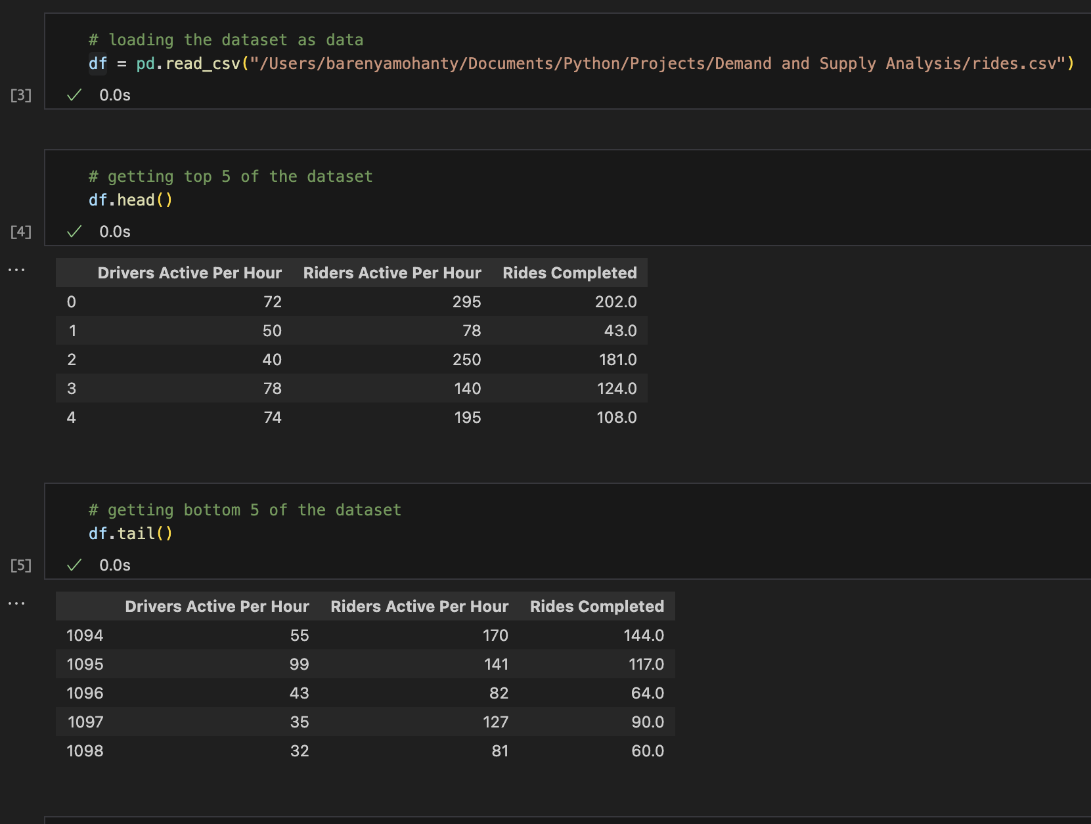
Data Cleaning
Data cleaning, also known as data cleansing or data preprocessing, is a crucial step in the data science pipeline. Data cleaning involves identifying and correcting or removing errors, inconsistencies, and inaccuracies in a dataset. The goal is to ensure that the data is accurate, consistent, and free of errors. Incorrect or inconsistent data can negatively impact the performance of machine learning models.

Slide 5
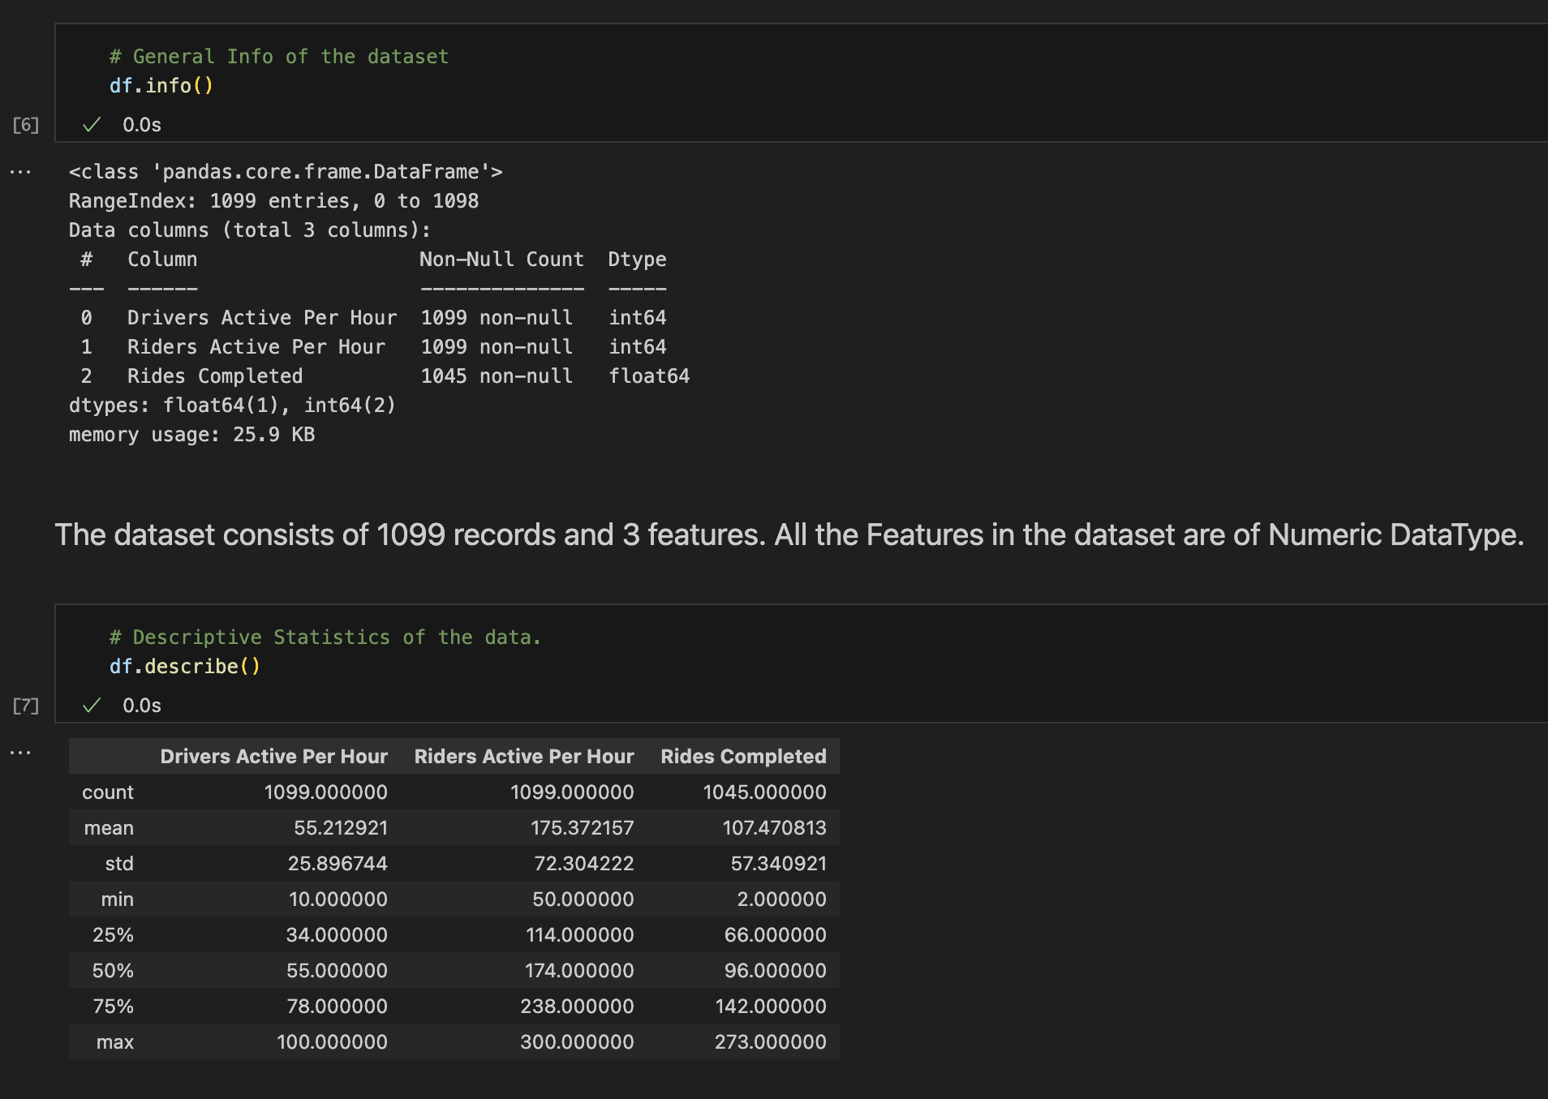

Slide 6
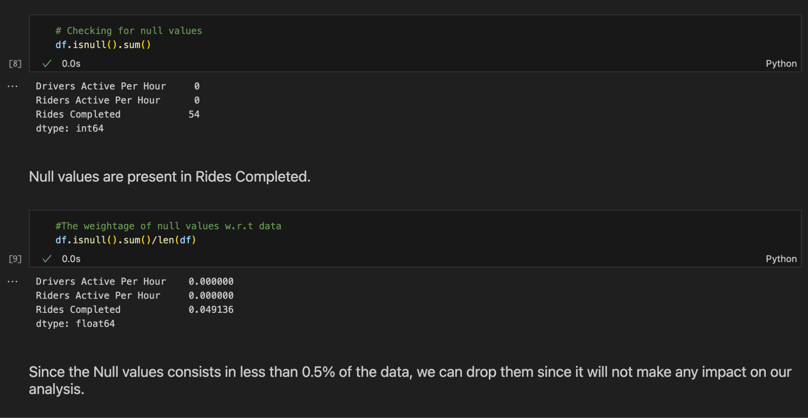

Slide 7
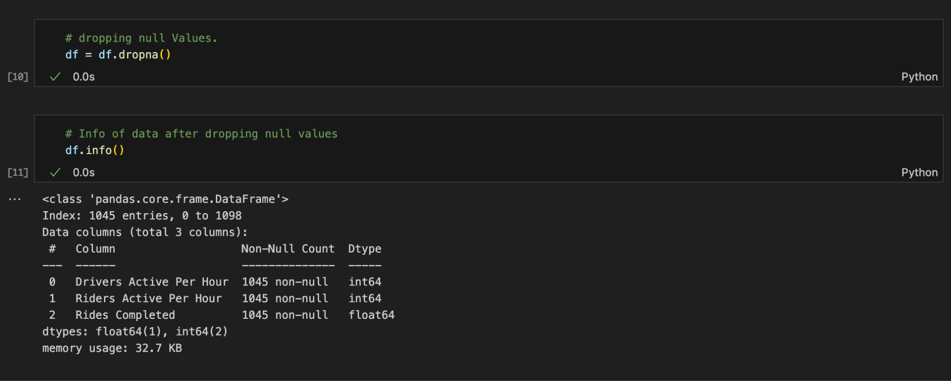

Slide 8
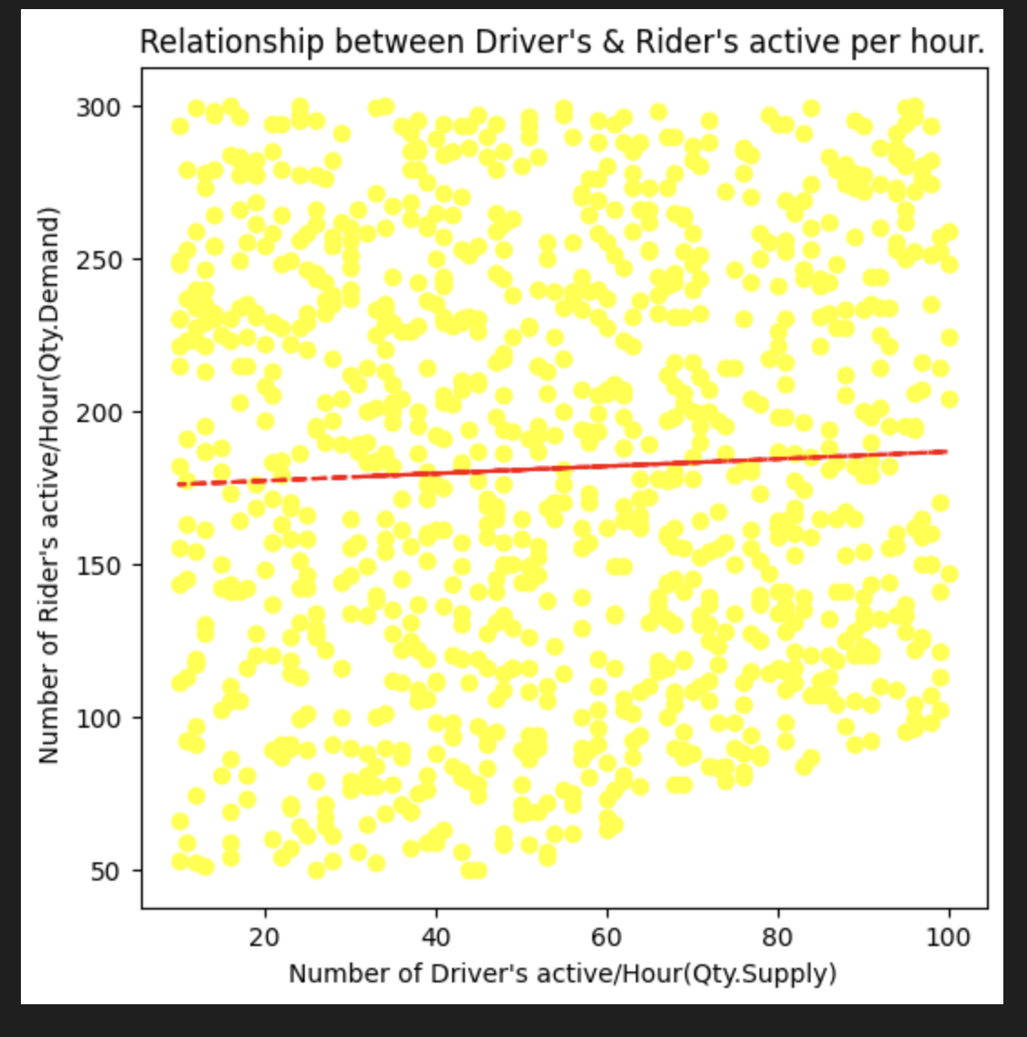
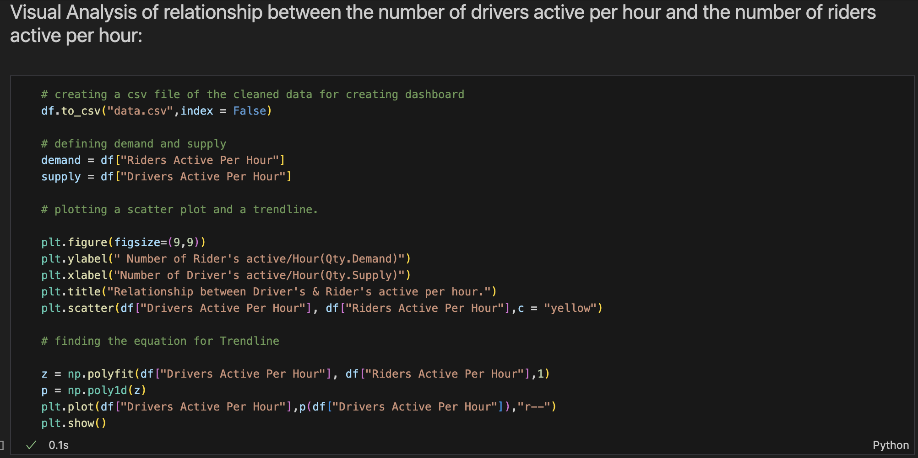
Plotting Graphs

Slide 9
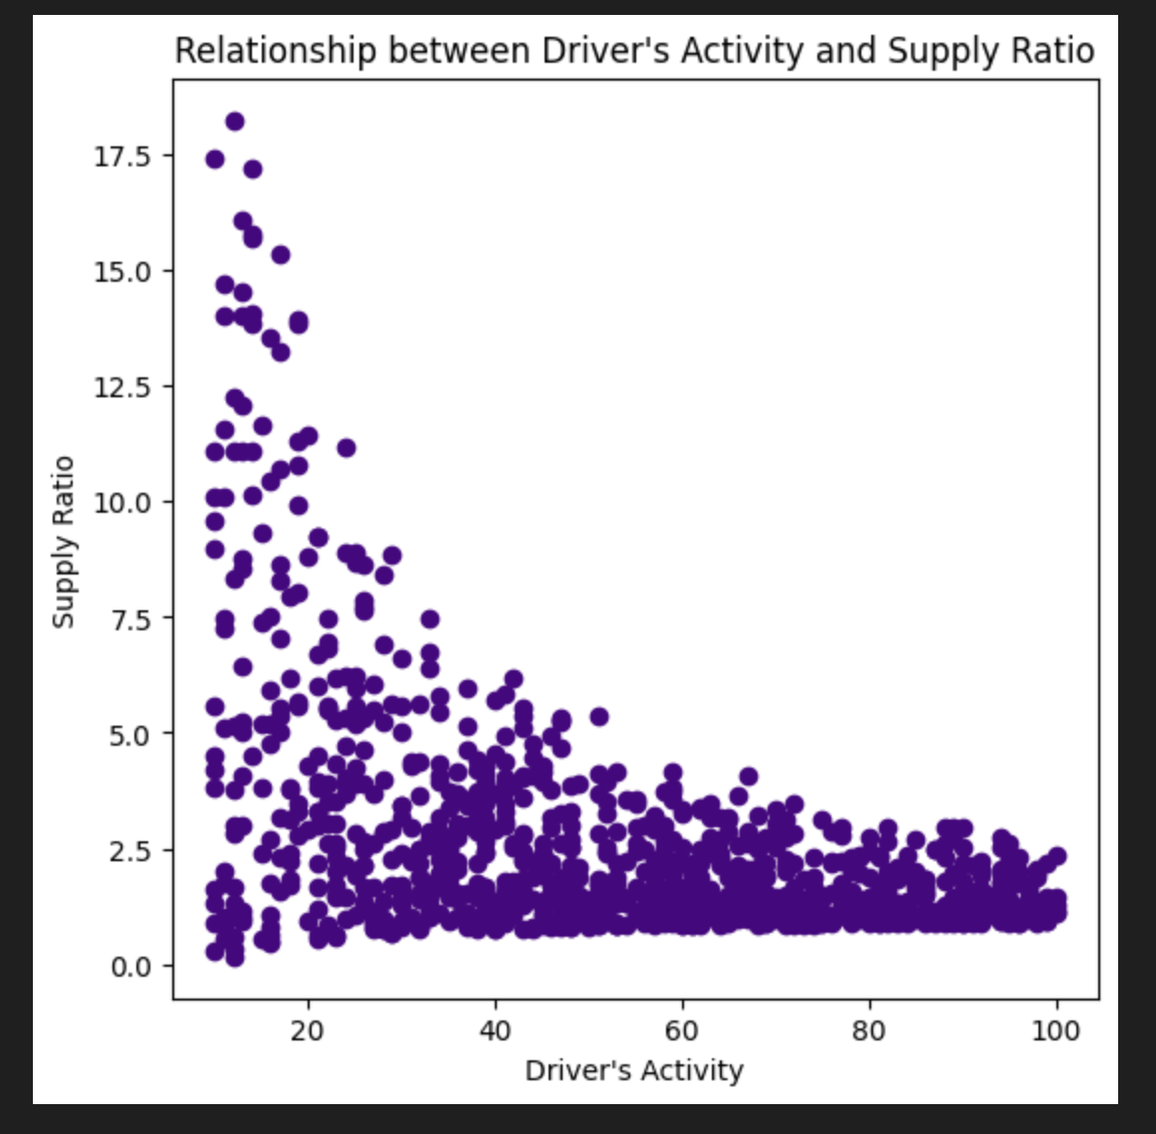
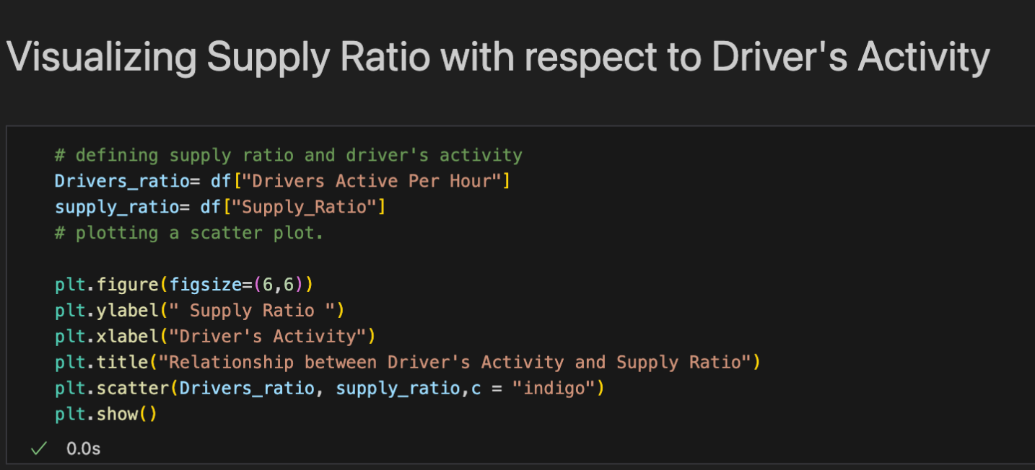

Slide 10
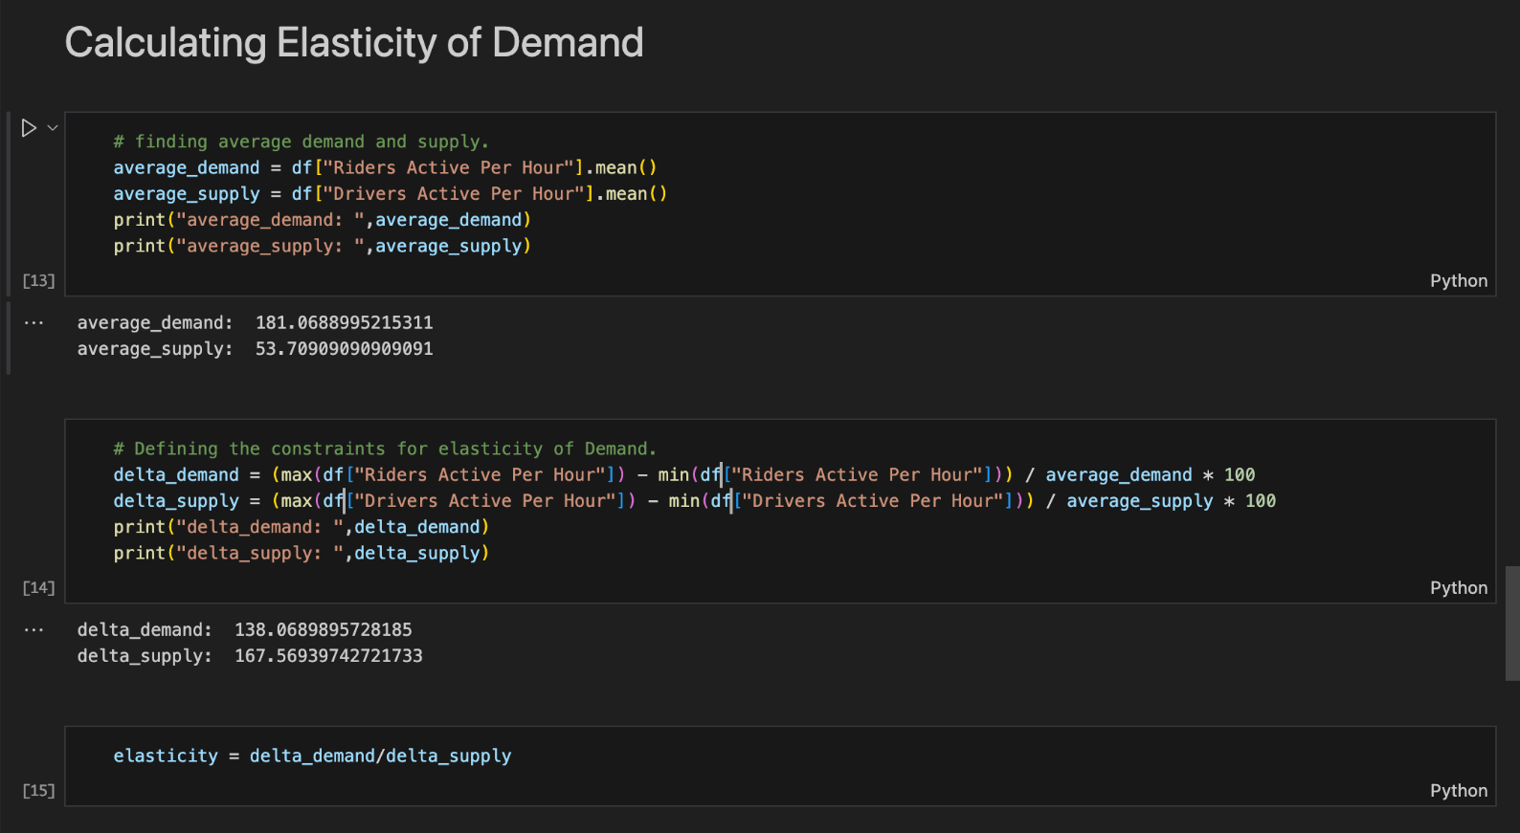
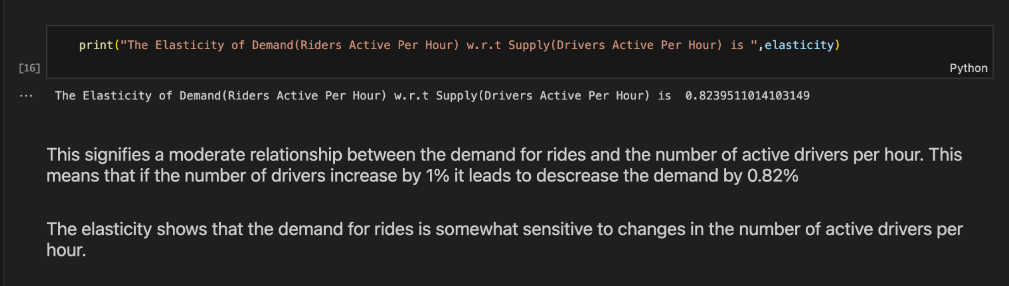
Calculating some terms related to Demand and Supply Analysis

Slide 11
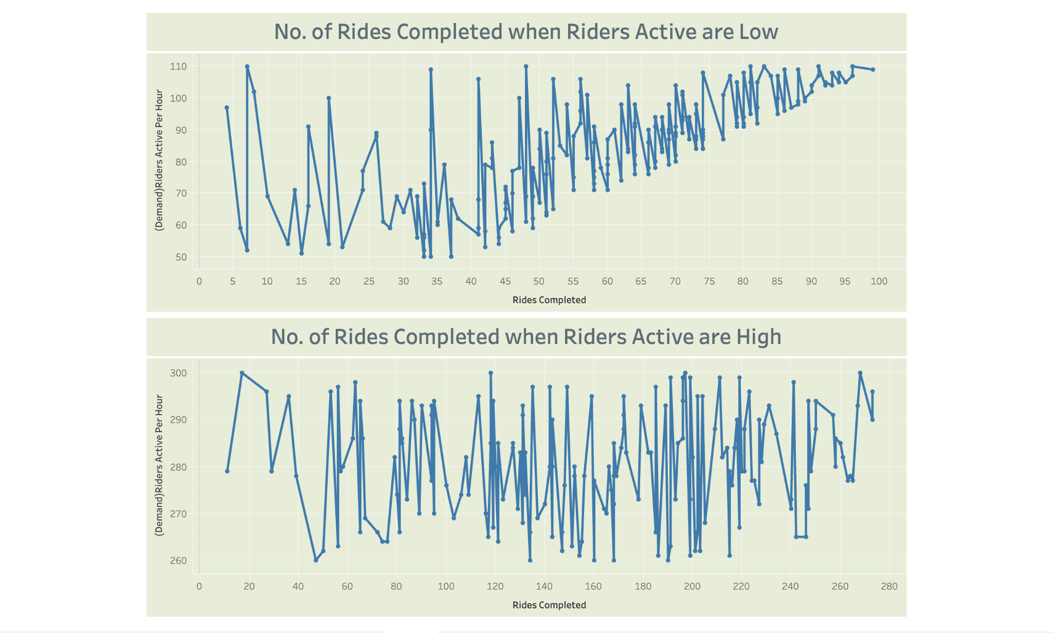
Dashboard using Tableau
Change in the trend of Graph for Rides completed along with the Riders Active
From the graph,
We can see that when the Riders active per hour are low the graph is steadily increasing
And, when the Riders active per hour are high the graph is remaining steady or constant.

Slide 12
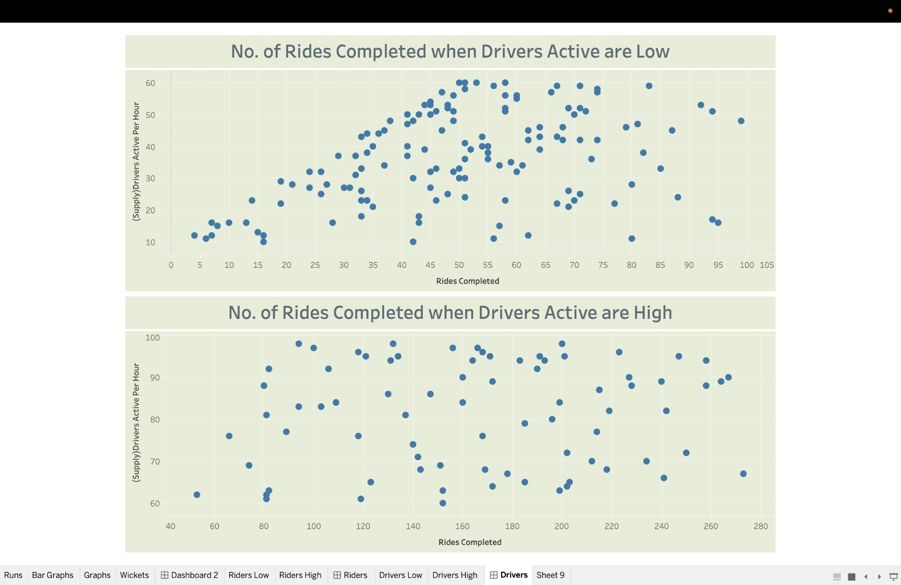
Dashboard using Tableau
Change in the trend of Graph for Rides completed along with the Drivers Active
From the scatter plot graph,
We can see that when the Drivers active per hour are low the graph is tightly coupled in some areas
And, when the Drivers active per hour are high the graph is loosely coupled.

Slide 13
CONCLUSION
Our analysis revealed a correlation between supply levels of cabs and the demand for cab rides. Python libraries like Pandas, Matplotlib facilitated efficient data cleaning and manipulation, allowing us to visualize these relationships through clear graphs and dashboards.

